Slide 1
Changing ALU Mode using the FSM Button Control
Speaker: Chi-Duong, Ngo(吳志陽)
StudentID: M11128033

Slide 2
Content
1. Introduction
2. Design
3. Result

Slide 3
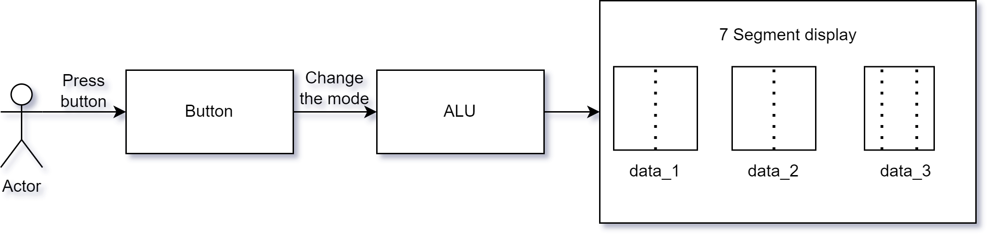
1. Introduction

Slide 4
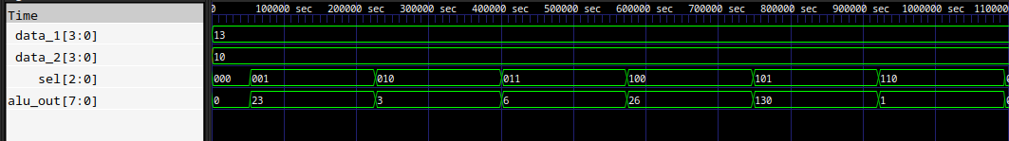
2. Design
ALU Module
Opcode [3 bits] | Function(Output)
001 | data_1 + data_2
010 | data_1 - data_2
011 | data_1 >> 1 => data1 / 2
100 | data_1 << 1 => data1 * 2
101 | data_1 * data2
110 | data1 / data2
000 | 0
111 | 0

Slide 5
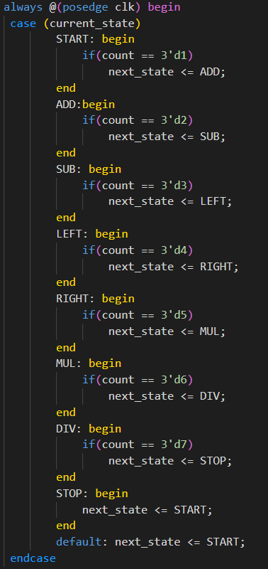
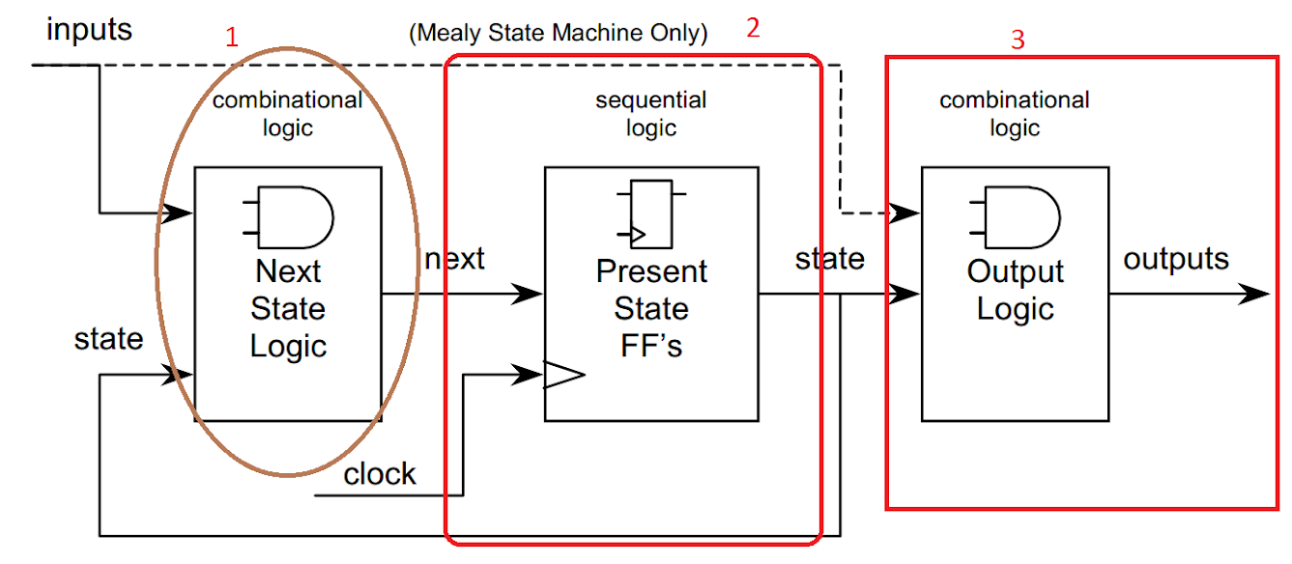
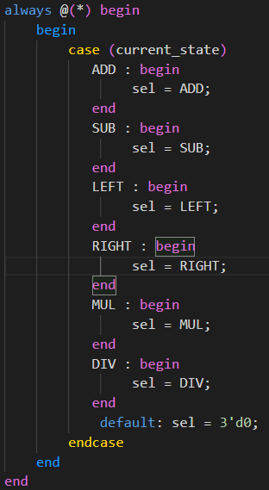
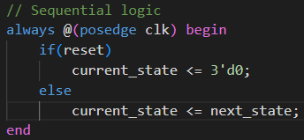
2. Design
BTN Control With FSM state

Slide 6
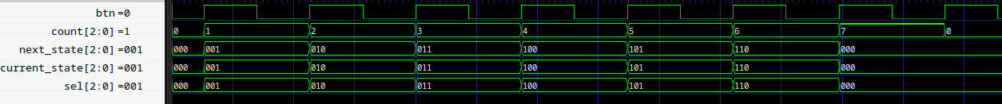
2. Design
BTN Control With FSM state
Count = 1
Count = 2
Count = 3
Start
000
ADD
001
SUB
010
LEFT
011
Count = 7
Count = 6
Count = 5
Count = 4
Count = 0
STOP
111
DIV
110
MUL
101
RIGHT
100

Slide 7
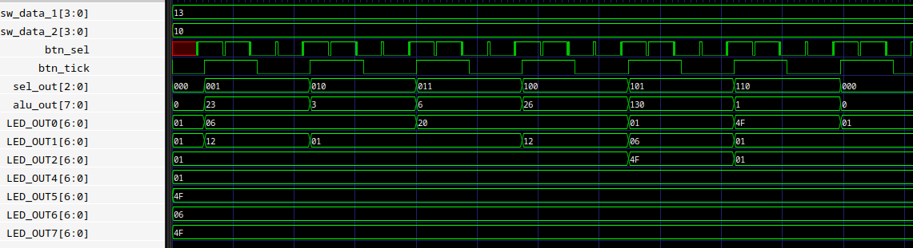
2. Design
Structure of Topmodule
Top Module
Sw_data_1
Sw_data_2
Debounce
BTN Control
ALU
7 Segment
btn_sel
btn_tick
sel_out
alu_out

Slide 8
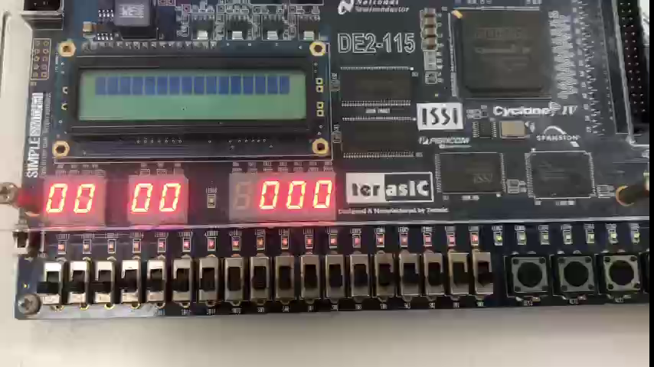
3. Result

Slide 9
Thank for your listening

